Slide 1

IoT-based Platform
Air Quality (PM2.5) Monitoring System
Project Members:
Suyogya Ratna Tamrakar (st121334)
Younten Tshering (st121775)
Smrity Baral (st121662)
Shubhangini Gontia (st121473)
Submitted to :
Dr. Apichon Witayangkuru
AT70.19 Software Development and Quality Improvement
Notes:
Durino

Slide 2
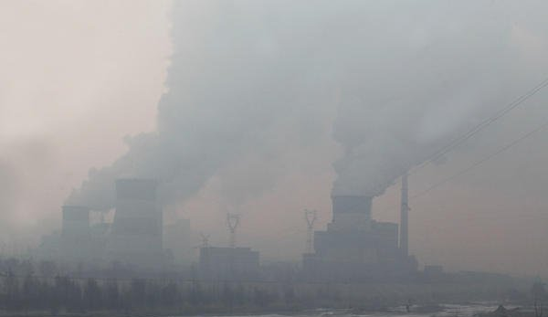
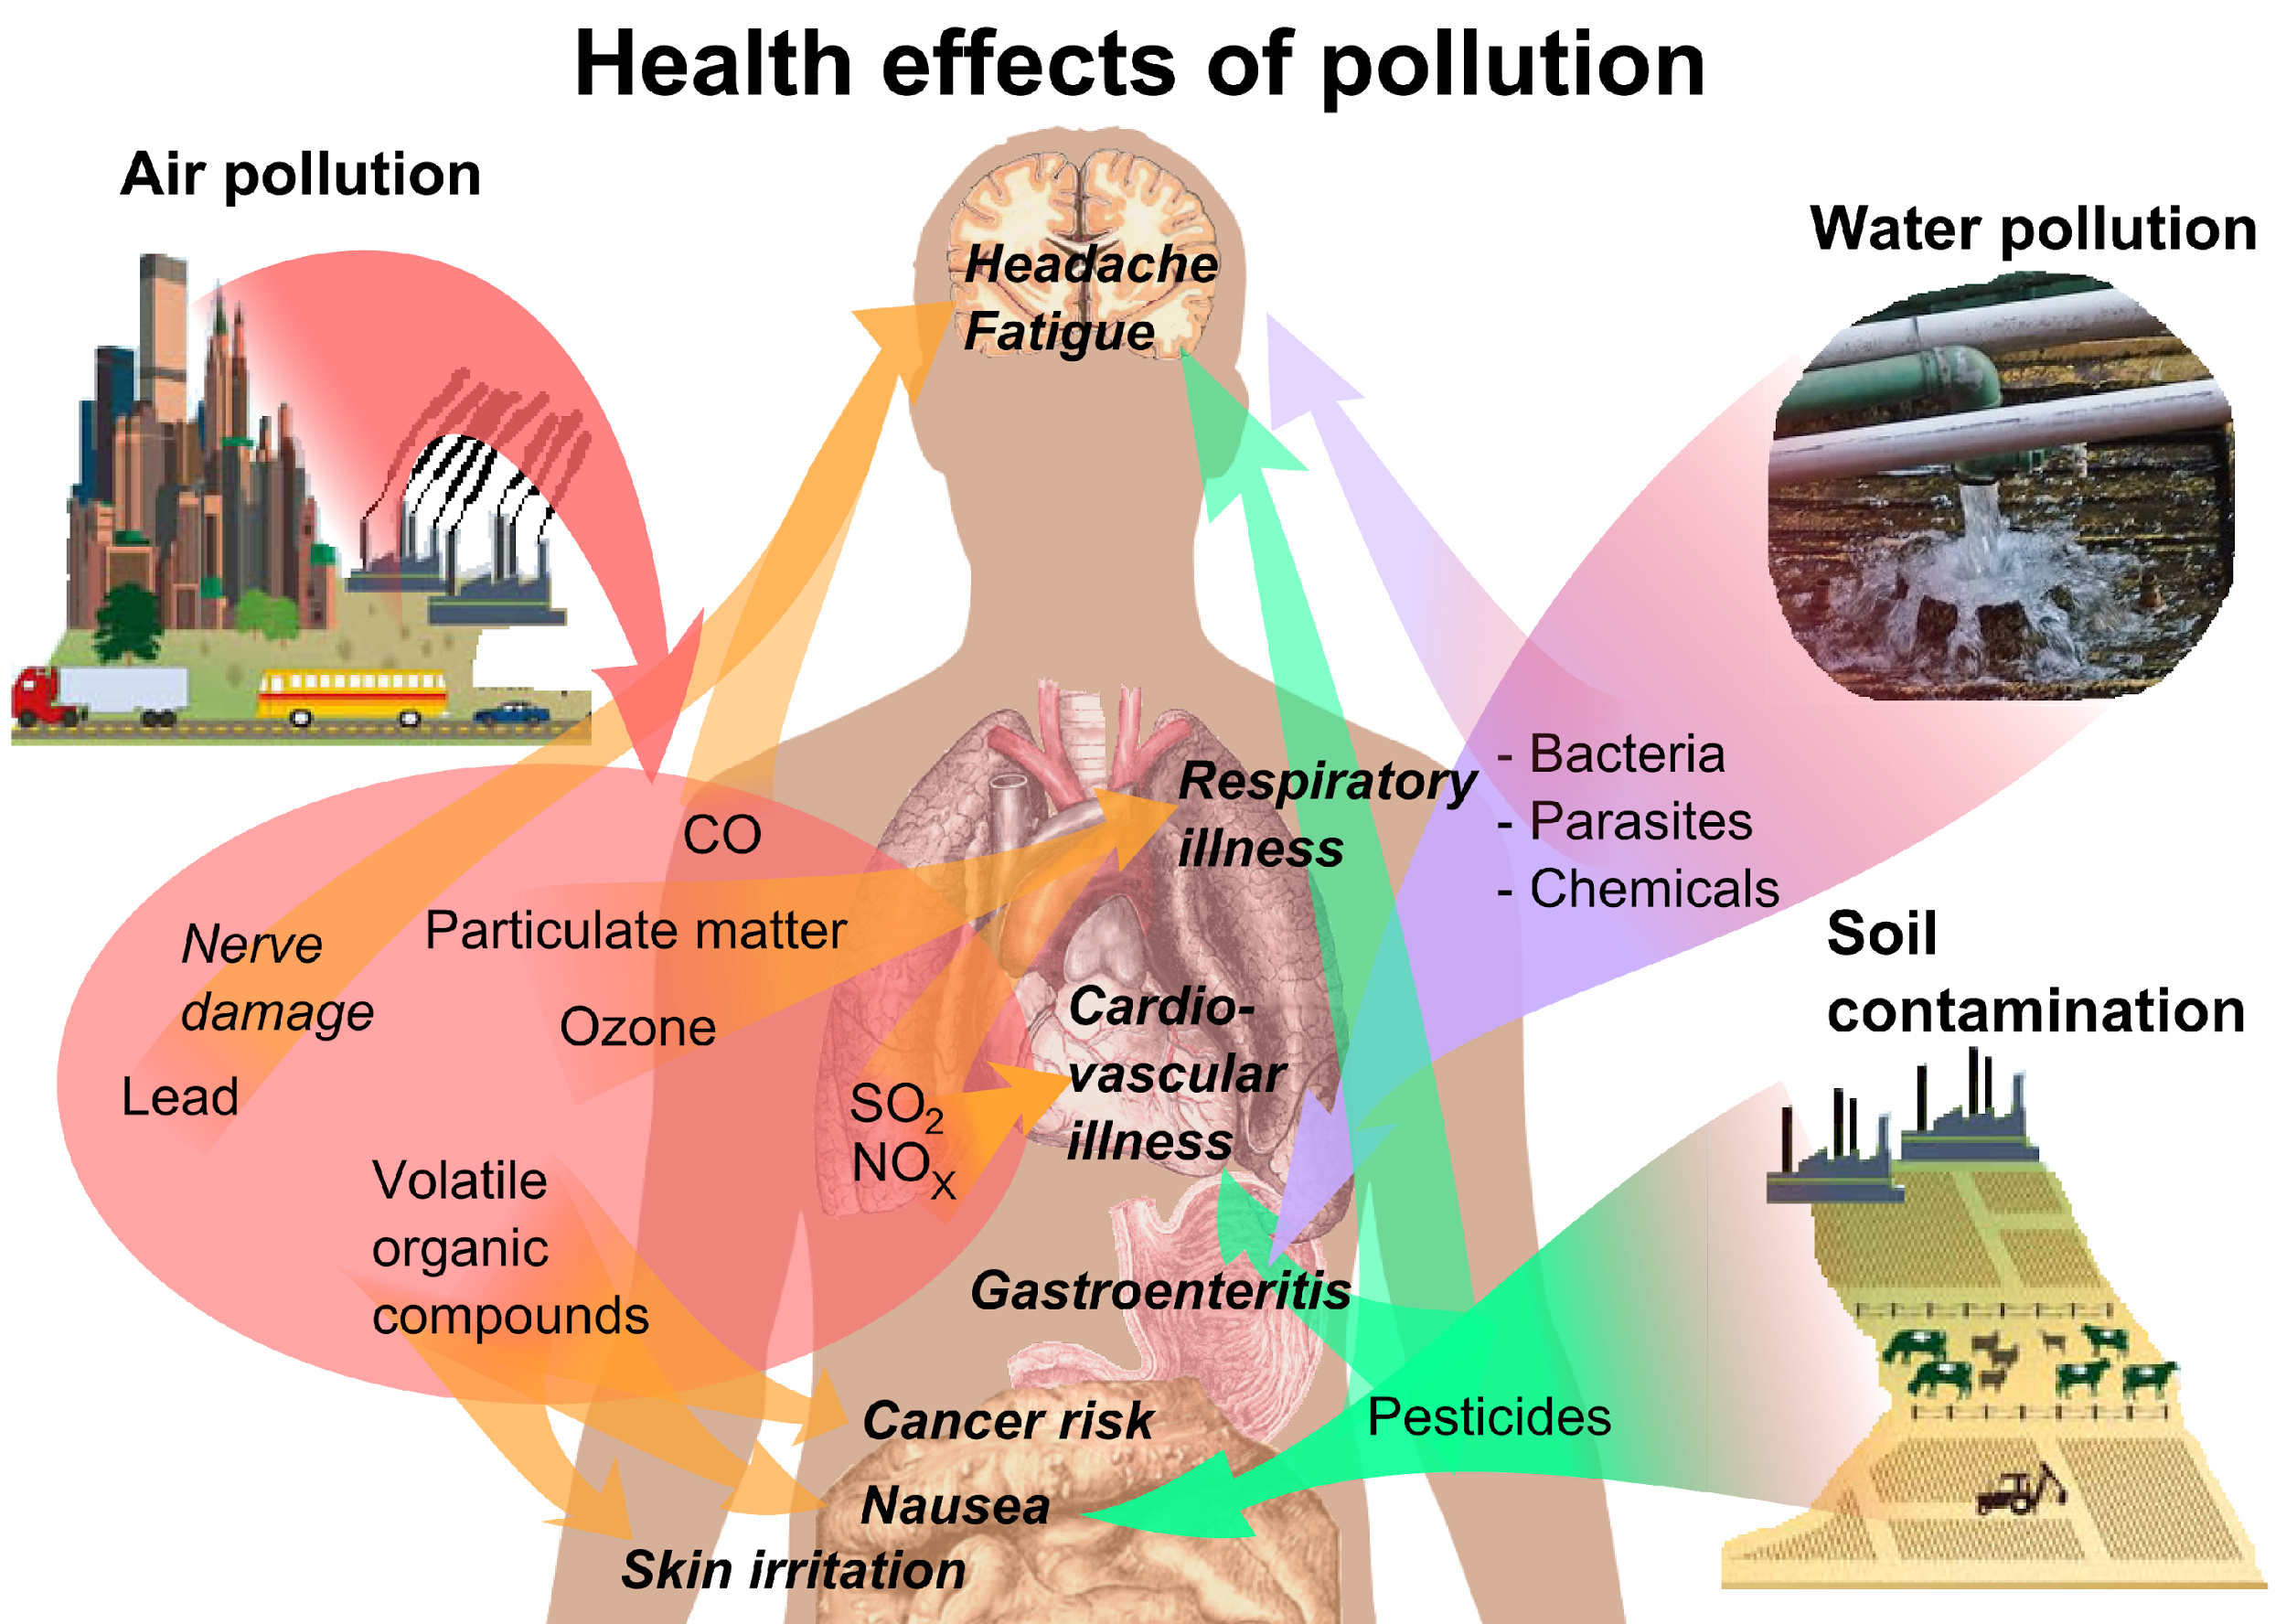
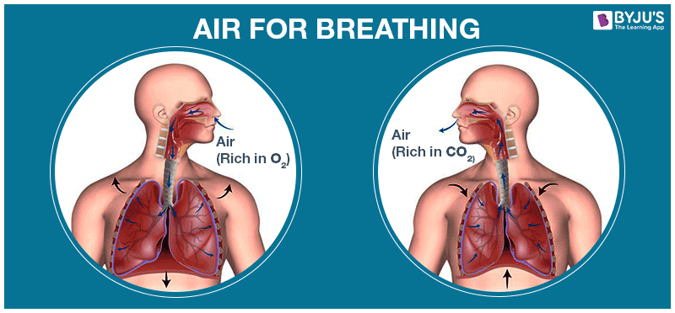
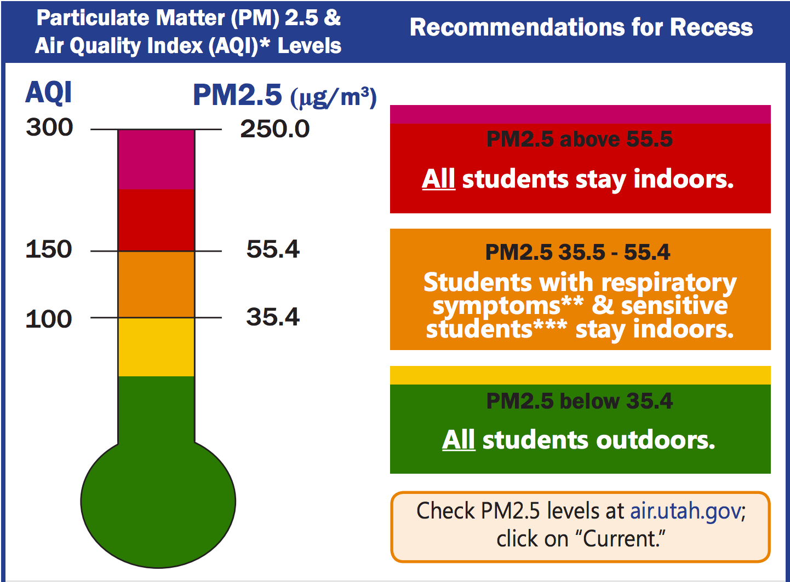
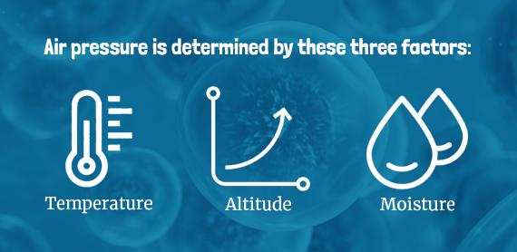
INTRODUCTION

Slide 3

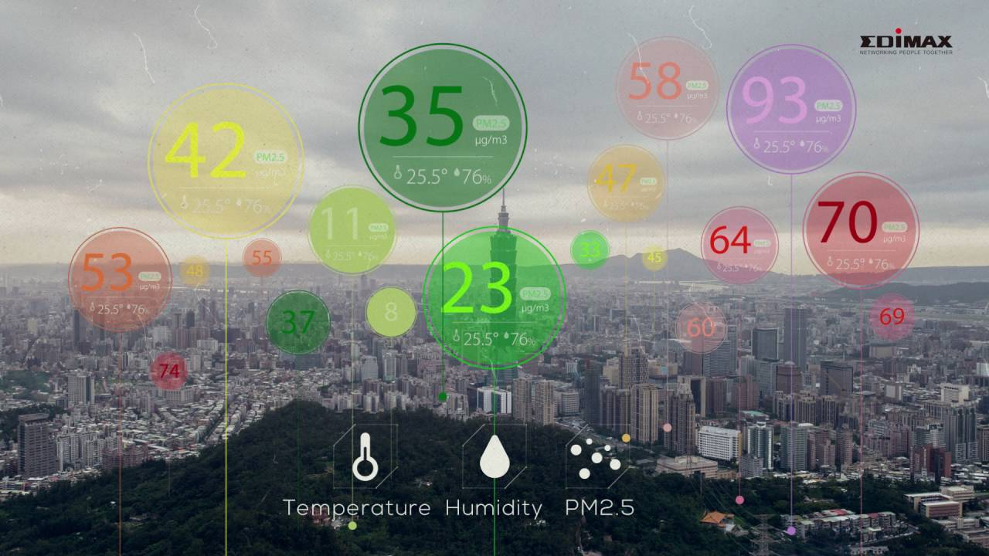
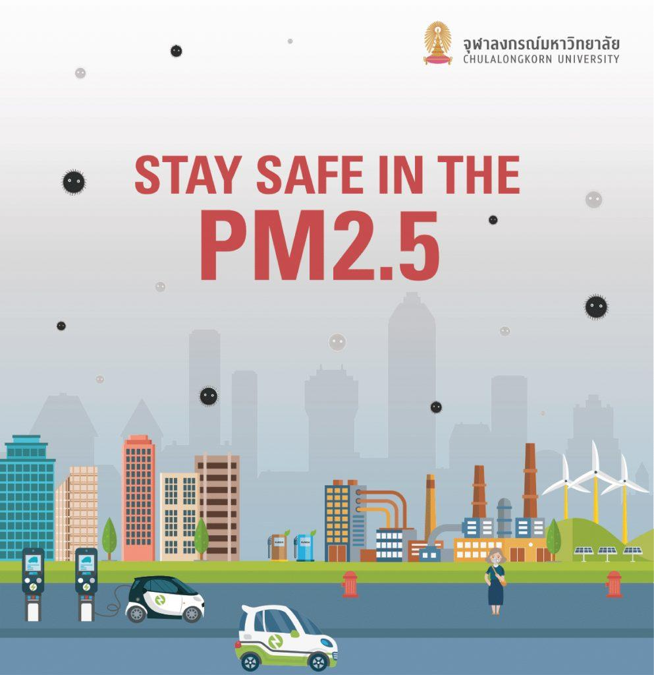
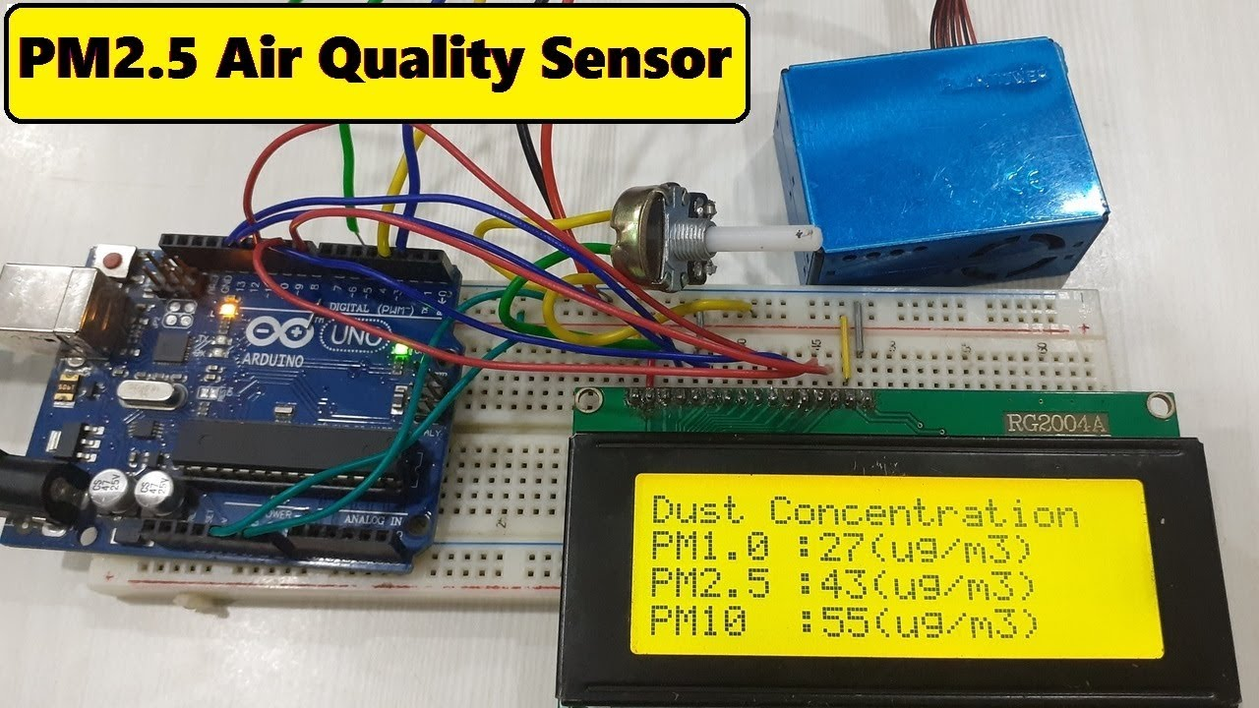
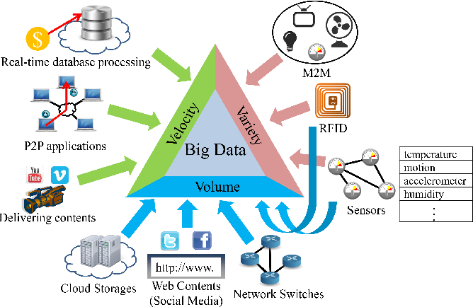
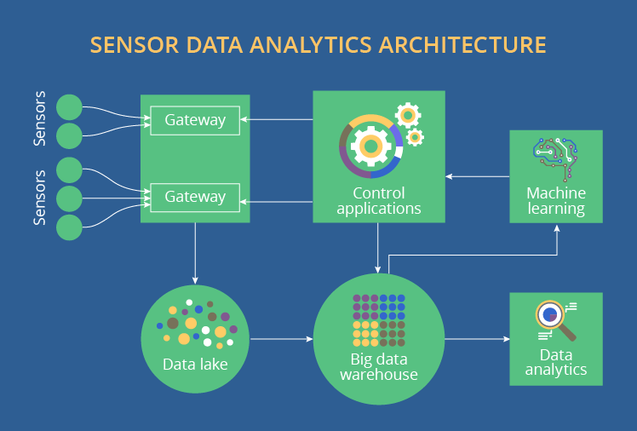
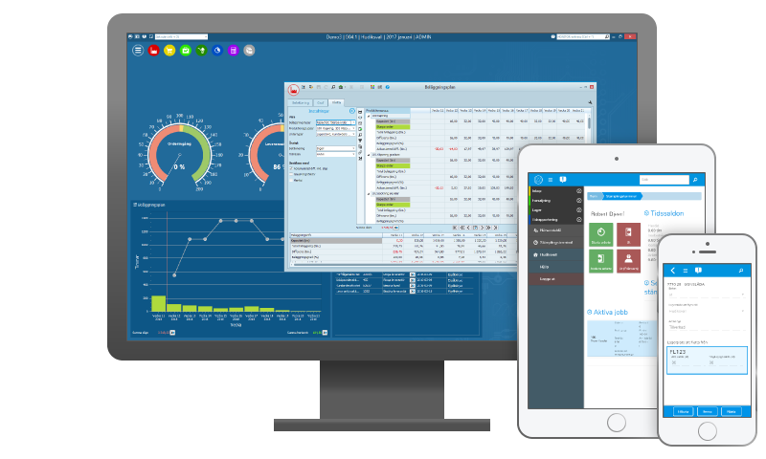
Develop air quality PM2.5 monitoring system.

Slide 4
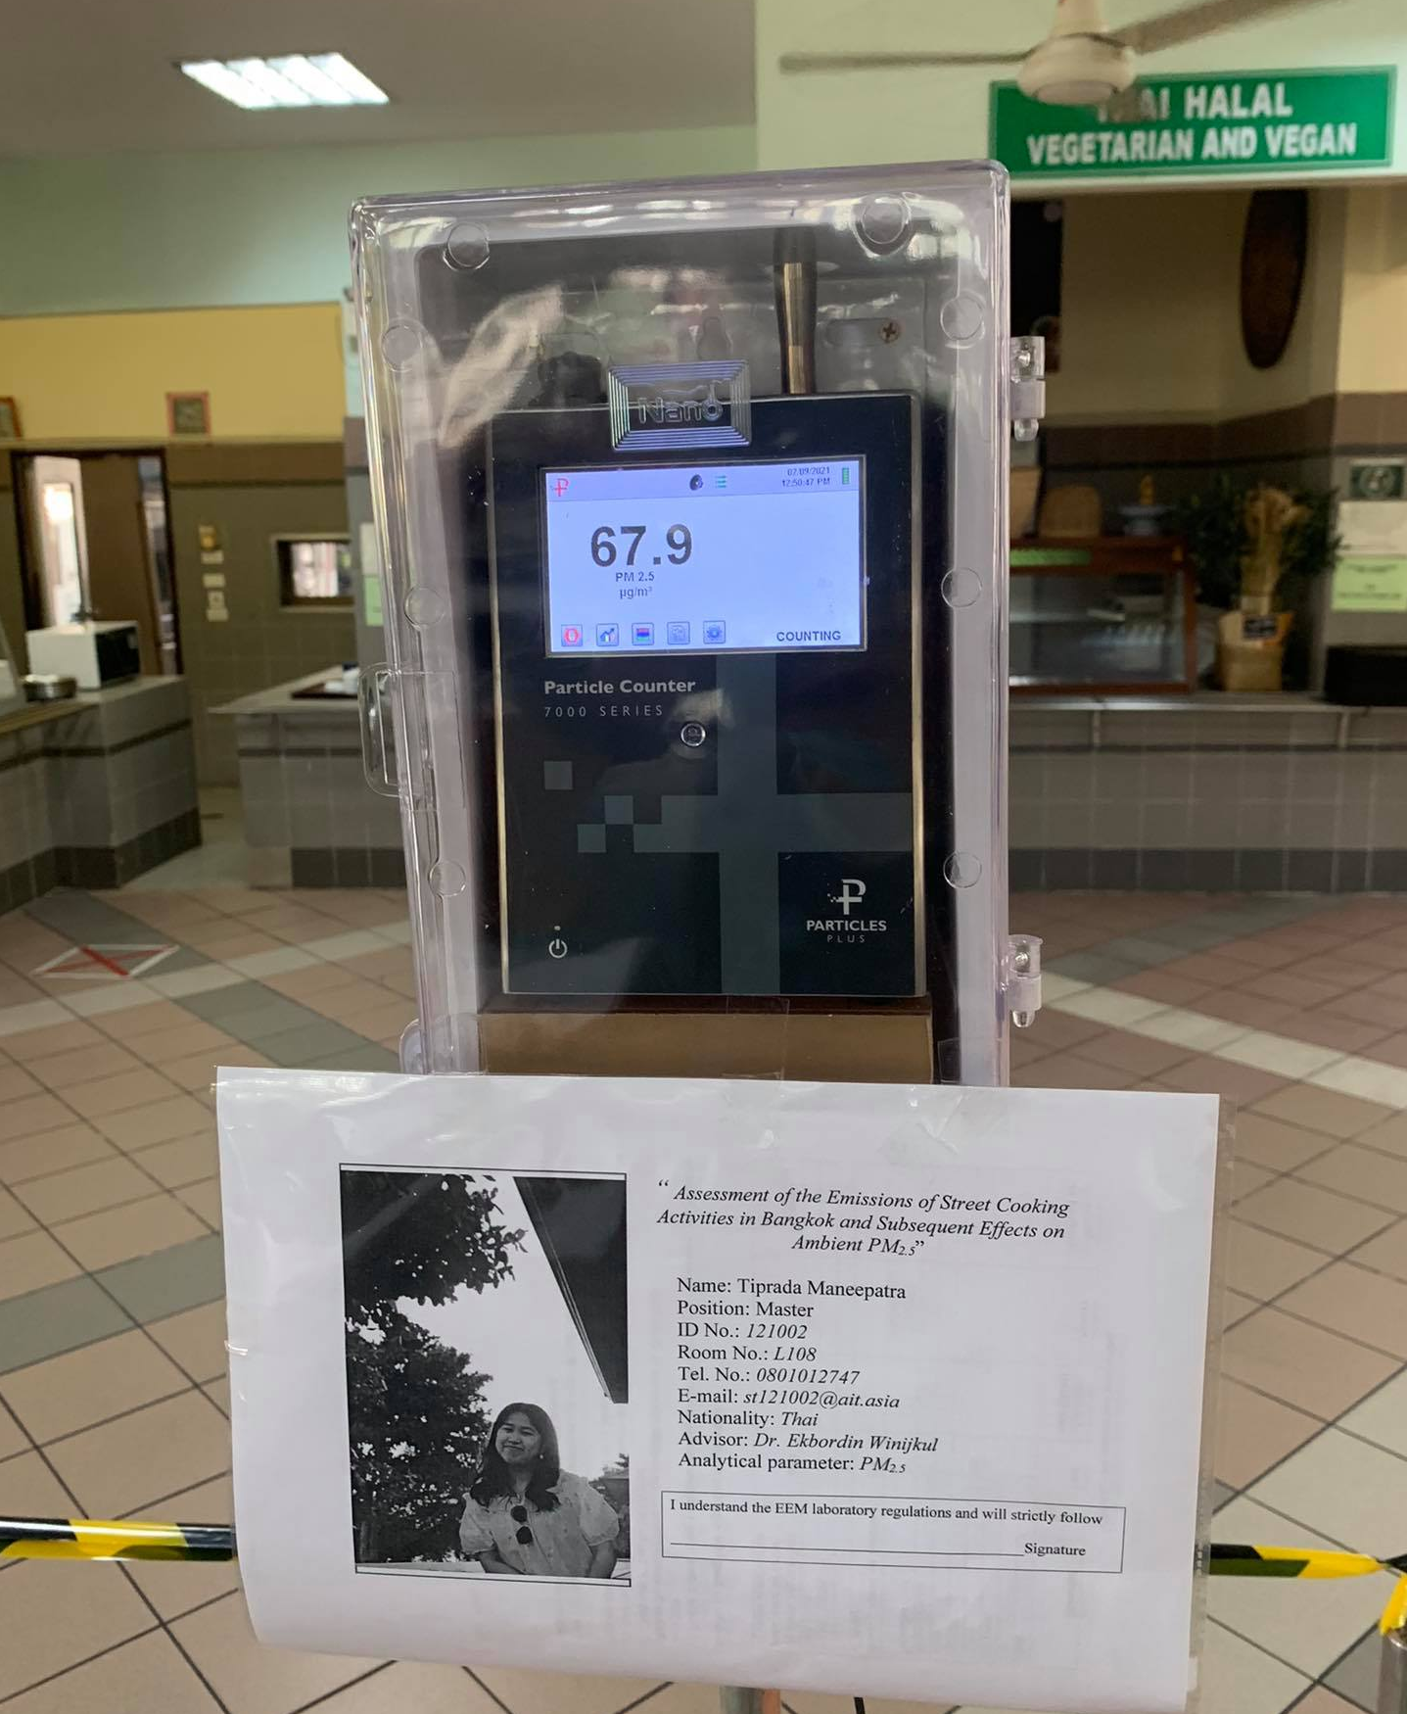

Slide 5
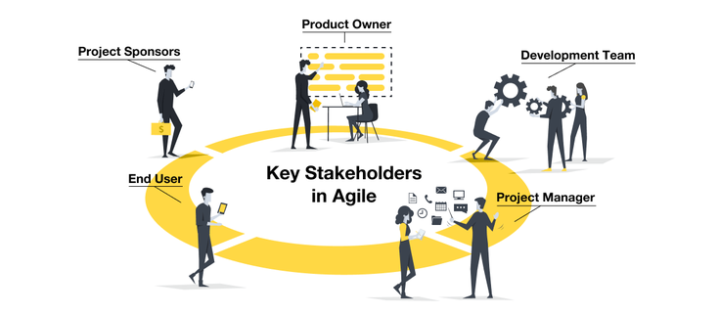







Key Users/Stakeholder
AIT staffs and Student
AIT management team
System Planning team
System Testing team
Clients/ End users
Investors
Developers

Slide 6
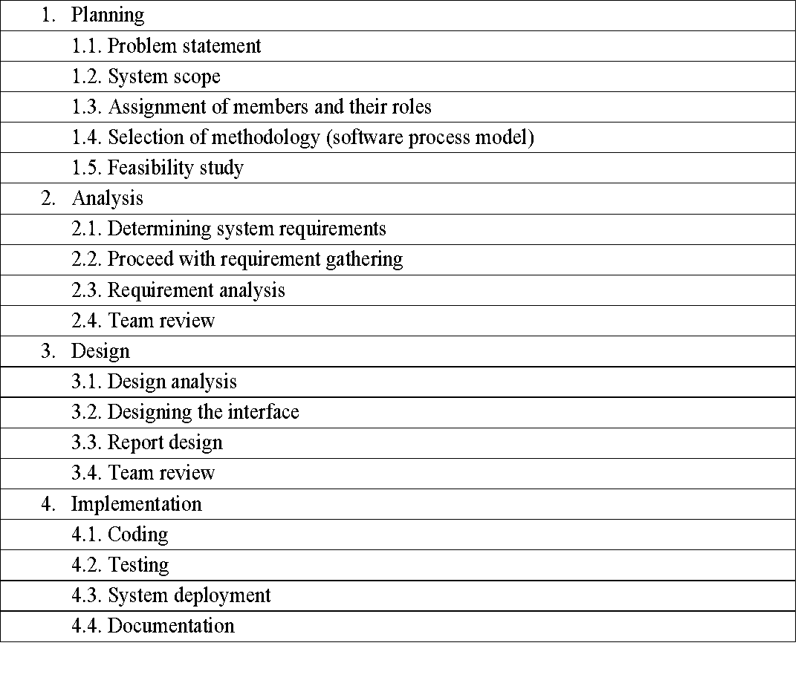
Work Break Down

Slide 7

Functional requirements:
Hardware, including the sensor like PM2.5 to measure the particles such as dust smoke or soot and temperature sensor as well.
Software, based on the data collected from the sensors will simulate the spatial distribution of pollution on a campus map.
Web App, will be designed such to display the measurement obtained from the sensor and visualize the resulting data.

Slide 8
Non-Functional requirements:
Performance
Performance is the highest factor because the large number of data collected from the sensor should be displayed on the responsive web application
Supportability
System should be maintained and will be able to support the correct and large amount of data
Usability
The application must be easy to use and understandable.

Slide 9
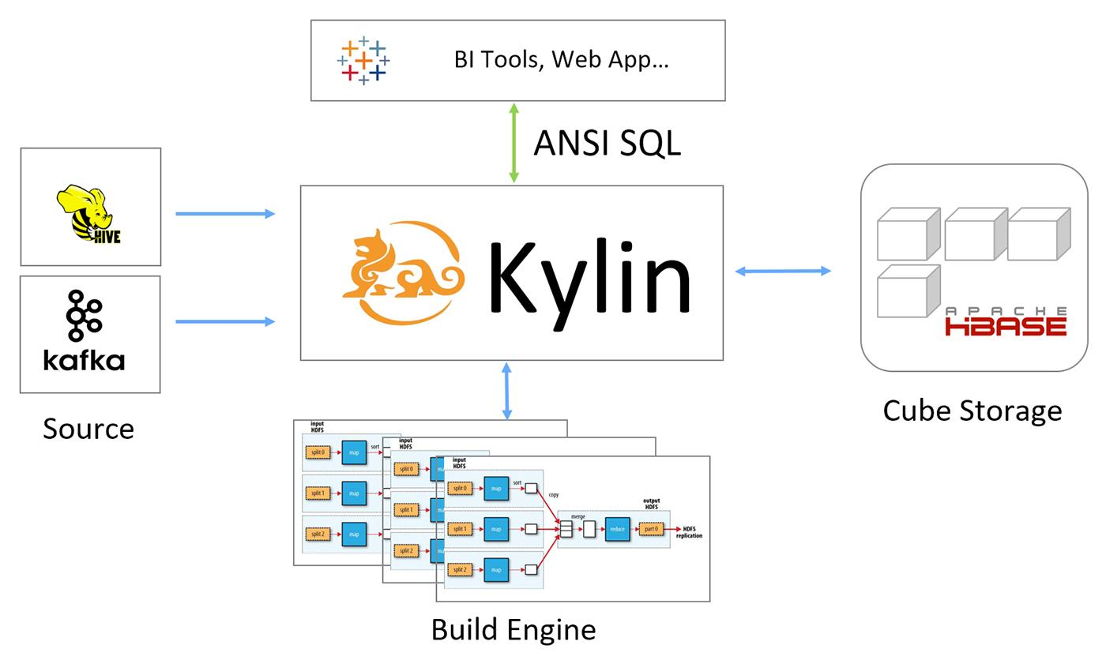
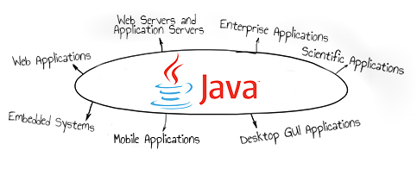
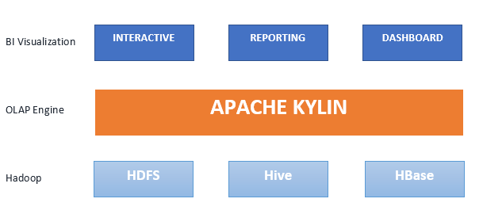
Programming Language:
JAVA
Framework and Tools:
Hadoop
Apache Kylin

Slide 10



CONCLUSION
The system ‘Air Quality (PM2.5) Monitoring System’ will be especially designed to be used by any organization.

Slide 11
Questions and
Feedback

